Slide 1
The Latin-American Laboratory for the Assessment of the Quality of Education (LLECE): Associated factors
Washington, 10 April 2014
UNESCO Regional Office for Education in Latin America and the Caribbean
1

Slide 2
What is the LLECE?
Aiming to (a) provide evidence for education policy. and (b) build capacities in educational assessment in LAC, in 1994, in Mexico City, the Latin American Laboratory for Assessment of the Quality of Education (LLECE) was founded (see: http://www.llece.org)
This consists of a network of national-level Directors of Educational Assessment in LAC, coordinated by UNESCO Santiago – OREALC
LLECE has since conducted 3 studies:
PERCE (1997)
SERCE (2006)
TERCE (2013)
EFA and youth transition to work
2
Notes:
2

Slide 3
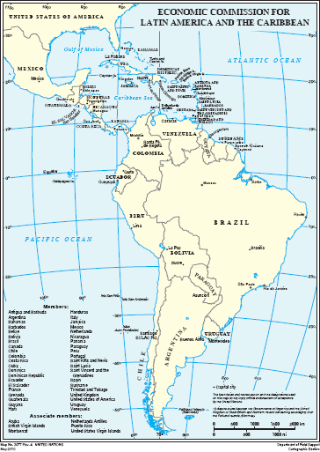
Which countries participate in TERCE?
Argentina
Brazil
Chile
Colombia
Costa Rica
Dominican Republic
Ecuador
Guatemala
Honduras
Mexico (and Nuevo León)
Nicaragua
Panama
Paraguay
Peru
Uruguay
3
Notes:
3

Slide 4
LLECE’s studies: who and what is assessed?
Study | Year | Grades | Maths | Science | Reading | Writing
PERCE | 1997 | 3 y 4 | x |  | x
SERCE | 2006 | 3 y 6 | x | x optional 6° | x | x
TERCE | 2013 | 3 y 6 | x | x obligatory 6° | x | x
EFA and youth transition to work
4
Notes:
4

Slide 5
Basic study design
The LLECE studies consist, in essence, of 2 axes:
A study of educational achievement level
A study of factors related to this
The first axis (large scale assessment of learning) is based on a regional curriculum analysis
The second axis is based on the generic CIPP model
EFA and youth transition to work
5
Notes:
5

Slide 6
TERCE: Basic timeline
Piloto (2012)
May – Jun: Northern hemisphere
Ago – Nov: Sothern Hemisphere
Definitiva (2013)
May – Jun: Northern hemisphere
Análisis (2014)
Analysis
First reports
Preparación (2011)
Curriculum analysis
Development of theoretical framework and tests
Ago – Nov: Sothern Hemisphere
6
Notes:
6

Slide 7
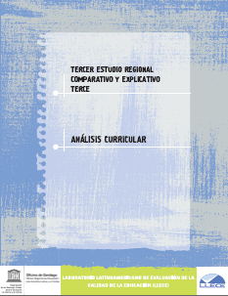
The fundament of TERCE: Curriculum analysis
TERCE started with a mapping of the curricula of the region’s countries, task conducted by ICFES (Colombia)
Based on this, regional specification tables were developed, which were used as the basis of the TERCE achievement tests
Recently published
Also has intrinsic value for countries to analyse their own curricula, in particular in comparison to others in the region
7
Notes:
7

Slide 8
TERCE: Analytical – conceptual model CIPP
Context (society)
Education context at home
Socioeconomic and cultural index
Gender
Indigenous populations
Input (system)
School infrastructure
Availability of computers
Pre-primary education
Repetition
Process (school)
School climate
School management
Teacher satisfaction
Teacher performance
Outcome
Learning
Civic education
Social and economic
participation
8
Notes:
8

Slide 9
Factors associated with learning achievement
4 questionnaires:
Learners (3rd and 6th grade)
Families
Teachers
Directors
Confidentiality is important
Based on theoretical framework, based, in turn, on regional literature review
EFA and youth transition to work
9
Notes:
9

Slide 10
Thank you for your time
Moritz BILAGHER Programme Specialist (Monitoring & Evaluation) / Coordinator of LLECE
UNESCO Santiago – OREALC
Santiago. Chile
E-mail : m.bilagher@unesco.org
Tel. : +56-2-24724601
10
Notes:
10

